Slide 1

Quantum in Bits:
An Introduction to Quantum Computation
By Samuel Crawford Loveys

Slide 2
Quantum Mechanics: Real Black Magic Calculus
- Albert Einstein
Agenda:
Introduce central concepts relating to Computer Science.
How does Quantum Mechanics change how we think of communication?
Code along of the Superdense Coding algorithm.
Quick talk through of Quantum Teleportation algorithm.
Applications in cryptography?
What can I study in the field of Quantum Computation / Information?
How does Quantum Mechanics change how we think of computational complexity?
Graph colouring, prime factorization, physics simulations, oh my!

Slide 3
Three Central Concepts
Superposition
*When a state in the present is determined in the future.
Entanglement
*When a state is changed by a second state that is in a superposition.
Measurement
When we observe a state, collapsing any superposition describing that state.
*There are other ways of describing these concepts.

Slide 4
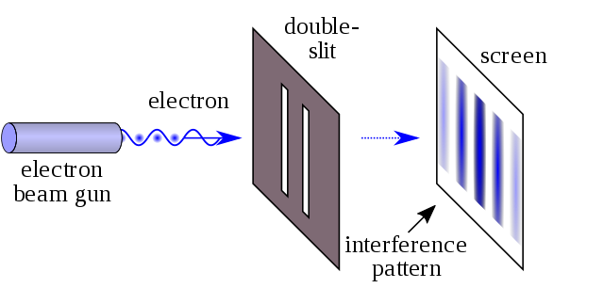

Slide 5
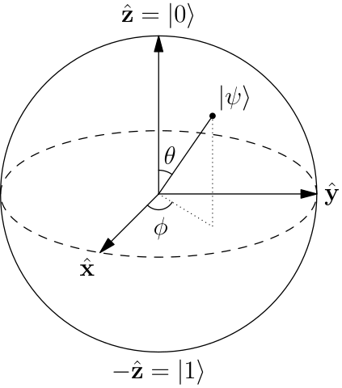

Superposition
Bloch Sphere notation:
Bra–ket notation: qubit = α|0> + β|1>
Such that ${\text{|}\text{α}\text{|}}^{\text{2}}$ + ${\text{|}\text{β}\text{|}}^{\text{2}}$ = 1
$\text{α}$ and $\text{β}$ are complex numbers
Matrix representation: $\left[\begin{matrix}\text{α} \\ \text{β}\end{matrix}\right]$

Slide 6

Single Qubit Gates
Pauli-X Gate
X = $\left[\begin{matrix}0 & 1 \\ 1 & 0\end{matrix}\right]$
X $\left[\begin{matrix}\text{α} \\ \text{β}\end{matrix}\right]$ = $\left[\begin{matrix}\text{β} \\ \text{α}\end{matrix}\right]$
Classical equivalent is the not gate.
Performs a rotation of pi around the x (normal) axis of the Bloch Sphere.
Consider qubit q with state |0>
X(q) results in q having the state |1>

Slide 7

Single Qubit Gates
Pauli-Y
Y = $\left[\begin{matrix}0 & −i \\ i & 0\end{matrix}\right]$
Performs a rotation of pi around the y (imaginary) axis of the Bloch Sphere.
Pauli-Z
Z = $\left[\begin{matrix}1 & 0 \\ 0 & −1\end{matrix}\right]$
Performs a rotation of pi around the z (phase) axis of the Bloch Sphere.
Identity
I = $\left[\begin{matrix}1 & 0 \\ 0 & 1\end{matrix}\right]$

Slide 8

Single Qubit Gates
Hadamard
H = $\frac{1}{\sqrt{2}} \left[\begin{matrix}1 & 1 \\ 1 & −1\end{matrix}\right]$
Commonly used to create some even superpositions.
What are some common solutions with the Hadamard gate?
H |0> = $\frac{|0> + |1>}{\sqrt{2}}$ and H $\frac{|0> + |1>}{\sqrt{2}}$ = |0>
H |1> = $\frac{|0> − |1>}{\sqrt{2}}$ and H $\frac{|0> − |1>}{\sqrt{2}}$ = |1>
In fact HH is the identity matrix! This is not a coincidence.
A gate is a valid quantum gate iff it is unitary. A gate U is unitary iff UU† = U†U = I
There’s an infinite number of valid single qubit quantum gates!

Slide 9

Entanglement
What would happen if we performed a controlled-not operation with a superposition state as the control bit?
Controlled-Not gate representation CX = $\left[\begin{matrix}\begin{matrix}1 & 0 \\ 0 & 1\end{matrix} & \begin{matrix}0 & 0 \\ 0 & 0\end{matrix} \\ \begin{matrix}0 & 0 \\ 0 & 0\end{matrix} & \begin{matrix}0 & 1 \\ 1 & 0\end{matrix}\end{matrix}\right]$
Consider q₀ and q₁ as our control and target qubits respectively.
If q₀ = $\frac{|0> + |1>}{\sqrt{2}}$ and q₁ = |0>, then collectively q₁q₀ = $\frac{|00> + |01>}{\sqrt{2}}$
After applying CX(q₀, q₁), the new sate of q₁q₀ = $\frac{|00> + |11>}{\sqrt{2}}$
$\frac{|00> + |11>}{\sqrt{2}}$ is called the Bell State.
The Bell State is a superposition between 00 and 11 with an even probability.

Slide 10

Measurement
Unlike in classical computing, measurement is an operation which changes a state.
Recall that a superposition is a state in the present that is determined in the future. When we attempt to observe which position that state is in (i.e. 1 or 0), then the state collapses into only be in one of its positions.
Consider the Bell State $\frac{|00> + |11>}{\sqrt{2}}$
If we observe this Bell State we will find the result 00 with a 50% probability or we will find 11 with a 50% probability.
If we repeat this measurement on the same qubits, then we will find the same state as the first measurement.
We no longer have the Bell State, instead we have the state |00> OR the state |11>.
What happens if we only measure one qubit?

Slide 11

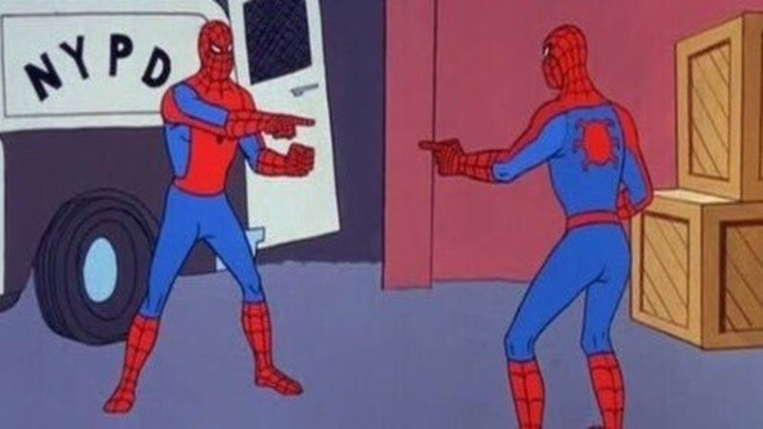

Slide 12
Is Entanglement a Form of Communication?
Yes! But it’s a bit weird.
Disclaimer: Nothing I say in this talk should be considered IT security advice.
Some quantum key distribution (QKD) algorithms use this entanglement “communication” to generate a random key between parties in a way that is provably secure. Such as the BB84 and E91 protocols.
We will not be getting into QKD algorithms today.
Please do NOT directly use these algorithms we’re going over for QKD. They are not secure.
Case examples:
Superdense Coding algorithm
Quantum Teleportation algorithm

Slide 13
Fields of Study in Quantum Computation
Cryptography
Quantum Search
Error-Correction
One of the primary problems currently being faced in QC.
Quantum Simulation
Of chemistry and nanotechnology ect.
Machine Learning
Quantum Circuits
And many more…

Slide 14
How Does This Relate to Computational Complexity?
For an n qubit computer, there is at most a superposition between 2^{n} distinct states which can be operated upon within a single execution.
For comparison the number of atoms in the observable universe is approximately 2²⁸⁶.
It is easy to simulate very small quantum computers, however for computers greater then 20 or 60 qubits this simulation quickly becomes a very hard problem.
This scaling is a good approximation of the efficiency gain that quantum algorithms can approach over classical algorithms.
There are many practical algorithms which take advantage of this efficiency.
Graph colouring, Shor's algorithm, neural network optimization and many more.
There are still many simple problems yet to be solved!

Slide 15
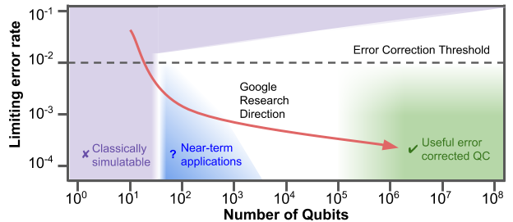
Why can we only run some of these algorithms?
Our quantum computers don’t have enough memory (qubits) to represent the problem.
Can we simplify our algorithm?
What trade offs between efficiency and required qubits are there?
The algorithm is programmed for a perfectly noise free system.
Our real quantum computers have lots of noise.
Can we redesign these algorithms to induce less noise?
Can we implement error correction?

